Slide 1

FINAL INTEGRATIVE PROJECT
Database of a Tourism company TucuMax
BASES DE DATOS-2024
MEMBERS:
PIAZZA, SANTIAGO NICOLÁS
VARGAS, ANTONIO JESÚS
CABRERA BELLOMO, TOMÁS

Slide 2


INTRODUCTION
In this project we will discuss about:
Abstraction Model
Entity-Relationship Model
Relational Model
Data Dictionary

Slide 3
GOALS TO ACHIEVE:
FUNCTIONAL DATABASE THAT:
Has logic and physical independence of data
Minimum data redundancy
Data integrity
Optimized complex queries

Slide 4

ASSUMPTIONS:
More than one service can be sold in one purchase
Events have a weekly frequency
Only one video or photo can be saved in a multimedia file

Slide 5
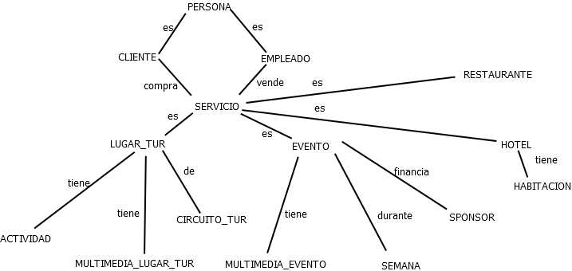
ABSTRACTION MODEL

Slide 6
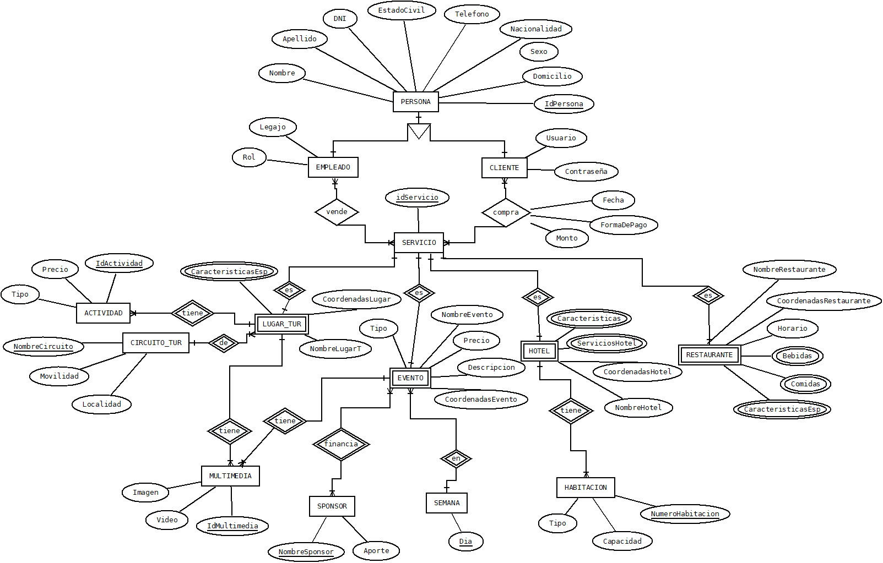
ENTITY-RELATIONAL MODEL

Slide 7
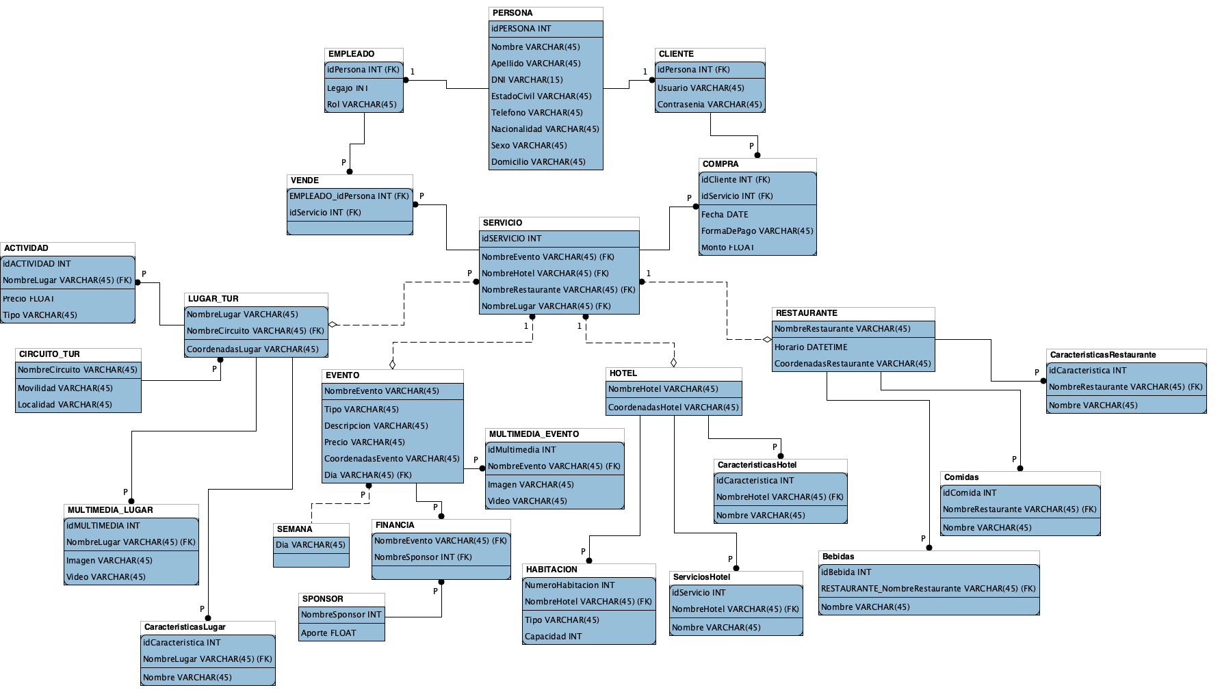
RELATIONAL MODEL

Slide 8
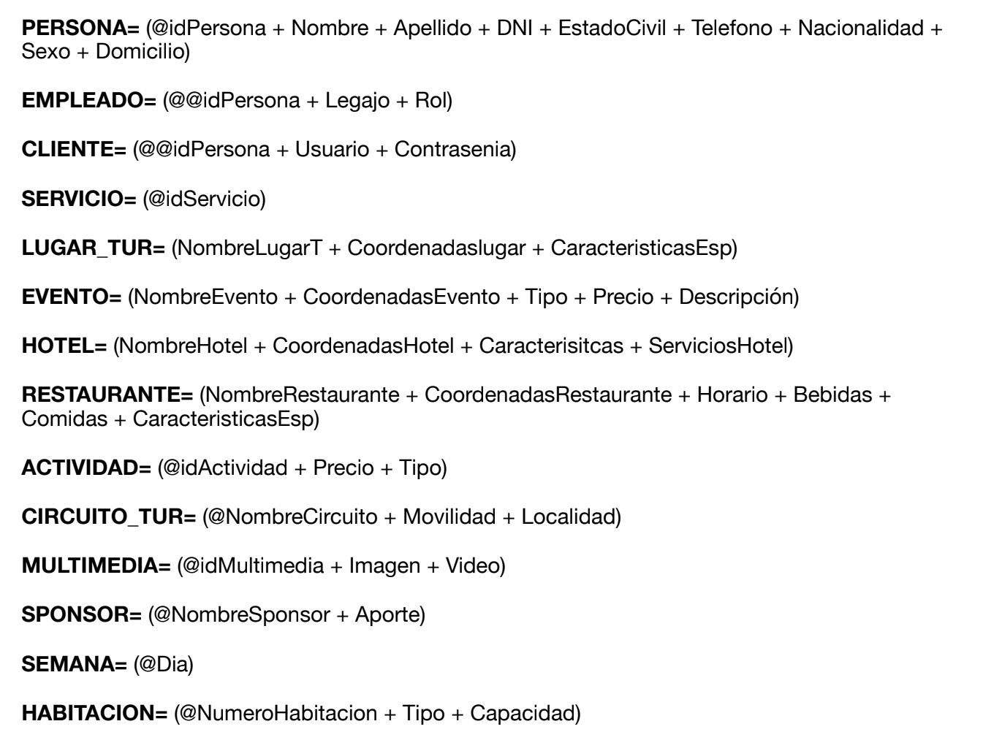
DATA DICTIONARY

Slide 9
CONCLUSIONS
There are certain important steps of reality analysis and abstraction before the development of a Database.
Models must represent reality without ambiguity.
It is important to keep data safe from unauthorized access.
Previous models are extremly important to create a correct Database

Slide 10


Slide 11
¿Preguntas?

